Slide 1
CSEN20
Fall 2026
Introduction to Embedded Systems
Michael Schimpf, PhD, mschimpf@scu.edu

Slide 2
Chapter 9
Getting Started with Floating Point
Notes:
The Cortex-M4 processor includes an optional FPU (or Floating Point Unit). It provides floating-point computation functionality that is compliant with the EEE 754 standard. The FPU supports all single-precision data-processing instructions and data types.

Slide 3
Floating Point Standard (Recall)
Defined by IEEE Standard 754 -1985
Developed in response to divergence of representations
Portability issues for scientific code
Now almost universally adopted
Two representations
Single precision (32-bit representation)
Double precision (64-bit representation)
https://www.h-schmidt.net/FloatConverter/IEEE754.html

Slide 4
Floating-Point Precision
Relative precision:
all fraction bits are significant
Single: approx 2^{–23}
Equivalent to 23 × log₁₀2 ≈ 23 × 0.3 ≈ 6 decimal digits of precision
Double: approx 2^{–52}
Equivalent to 52 × log₁₀2 ≈ 52 × 0.3 ≈ 16 decimal digits of precision

Slide 5
Floating Point (recall)
Representation for non-integral numbers
Including very small and very large numbers
Like scientific notation
–2.34₁₀ × 10⁵⁶
+0.002₁₀ × 10^{–4}
+987.02₁₀ × 10⁹
In binary
±1.xxxxxxx₂ × 2^{yyyy}
Types in C: float (single-precision FP) and double (double-precision FP)
normalized
not normalized
normalized
Notes:
For very small and very large numbers, we can not represent them in integer format. Computer arithmetic that supports such very small and very big numbers is called floating point because it represents numbers in which the binary point is not fixed (unlike the case for the integers).
In applied mathematics, a number is normalized when it is written in scientific notation with one nonzero decimal digit before the decimal point.

Slide 6
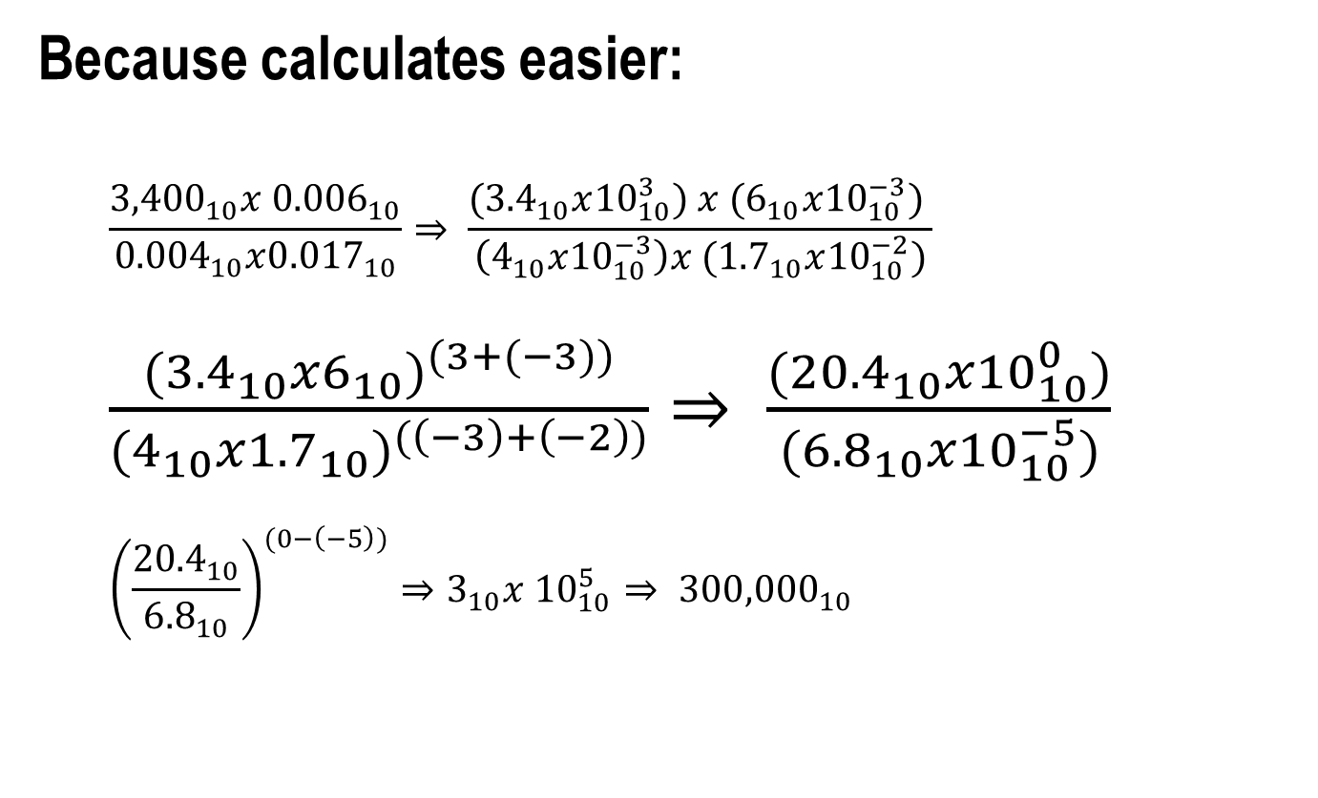
Scientific Notation (why?)
Because calculates easier:
$$\frac{{3,400}_{10}x {0.006}_{10}}{{0.004}_{10}x{0.017}_{10}}⇒ \frac{({3.4}_{10}x{10}_{10}^{3}) x {(6}_{10}x{10}_{10}^{−3}) }{\left(4_{10}x{10}_{10}^{−3}\right)x ({1.7}_{10}x{10}_{10}^{−2})}$$
$\frac{{({3.4}_{10}x6_{10})}^{(3+(−3))}}{{(4_{10}x{1.7}_{10})}^{(\left(−3\right)+\left(−2\right))}}⇒ \frac{({20.4}_{10}x{10}_{10}^{0})}{{(6.8}_{10}x{10}_{10}^{−5})}$
$${\left(\frac{{20.4}_{10}}{{6.8}_{10}}\right)}^{(0−\left(−5\right))}⇒3_{10}x {10}_{10}^{5}⇒ {300,000}_{10}$$
NOT normalized
normalized
Superscript = exp
Subscript = base
Notes:
For very small and very large numbers, we can not represent them in integer format. Computer arithmetic that supports such very small and very big numbers is called floating point because it represents numbers in which the binary point is not fixed (unlike the case for the integers).
In applied mathematics, a number is normalized when it is written in scientific notation with one nonzero decimal digit before the decimal point.

Slide 7
Floating Point
In binary
±1.xxxxxxx₂ × 2^{yyyy} (for example, 1.0₂ x 2⁻¹=> 0.1₂)
Base 2
Binary
point
fraction
exponent
A tradeoff between precision and range.
Notes:
Now, a designer of a floating-point representation must find a compromise between the size of the fraction (0<number<1) and the size of the exponent because a fixed word size, means you must take a bit from one to add to the other (a tradeoff between precision and range).

Slide 8
IEEE 754 Floating-Point Format
Example: -111111.01 x 2⁷
+ 127
S
Stored Exp.
Fraction
single: 8 bits
single: 23 bits
Notes:
Like I mentioned earlier, the 754 is a technical standard for floating-point arithmetic established in 1985 by the IEEE. The 1985 version covered only binary floating-point but the current version which was published in 2019, covers all aspects of floating point arithmetic.
S: sign bit (0 ⇒ non-negative, 1 ⇒ negative).
Normalize significand: 1.0 ≤ |significand| < 2.0.
Always has a leading pre-binary-point 1 bit, so no need to represent it explicitly (hidden bit).
Significand is Fraction with the “1.” restored.

Slide 9

FLOATING-POINT DATA TYPE
Single-precision floating-point (float)
Excess-127 format
2⁰ → 01111111
Normalized: MS-Bit is always 1; never stored
31
30
23
22
0
±
Exponent
Significand
8 bits
23 bits
Range: 2^{±127} ≈ 10^{±38}
Precision: 23 bits ≈ 7 decimal digits
0 if positive,
1 if negative
Our Cortex-M4 FPU doesn’t support double!
Notes:
The FPU of Cortex-M4F can only perform arithmetic using single-precision real numbers – identical to the C type float (does not the C type double). Although it does not support double arithmetic but the FPU registers can store doubles. One can use a pair of PFU resisters to just store a double.

Slide 10
float versus int32_t
31 |  |  |  |  |  |  |  |  |  |  |  |  |  |  |  |  |  |  |  |  |  |  |  |  |  |  |  |  |  |  | 0
0 | 0 | 0 | 0 | 0 | 0 | 0 | 0 | 0 | 0 | 0 | 0 | 0 | 0 | 0 | 0 | 0 | 0 | 0 | 0 | 0 | 0 | 1 | 1 | 1 | 1 | 1 | 0 | 1 | 0 | 0 | 0
int32_t y = 1000₁₀;
Standard Integer
value₂ = + 1.111101000 × 2⁹ or (1000₁₀)
31 | 30 | excess 127 exponent |  |  |  |  |  | 23 | 22 | significand |  |  |  |  |  |  |  |  |  |  |  |  |  |  |  |  |  |  |  |  | 0
0 | 1 | 0 | 0 | 0 | 1 | 0 | 0 | 0 | 1 | 1 | 1 | 1 | 0 | 1 | 0 | 0 | 0 | 0 | 0 | 0 | 0 | 0 | 0 | 0 | 0 | 0 | 0 | 0 | 0 | 0 | 0
float x = 1000.0₁₀;
float
9+127 =136₁₀
111101
http://www.h-schmidt.net/FloatConverter/IEEE754.html
Notes:
1000₁₀ = 11111010_{2.} = 1.111101000 x 2⁹
Stored exponent = 127 + 9 = 136

Slide 11
Single-precision Floating-point Representing Zero and One
S(1) Exp+127(8) (implied 0).Significand(23)
0.000 0 00000000 (0).00000000000000000000000
Implied 0, if and only if, both stored exponent and the fractional part are zero.
S(1) Exp+127(8) (implied 1).Significand(23)
0.000 0 01111111 (1).00000000000000000000000
1.000₁₀ -> 0001₂ then normalize it as 1.0 x 2⁰
Actual exponent = 0 so the stored storage in single precision becomes 0+127 = 127 or 01111111

Slide 12
Floating-Point Example 1
Representing decimal 2.0 in IEEE 754 single-precision format:
Notes:
IEEE 754 standard for single-precision floating point number..

Slide 13
Floating-Point Example 1
Binary number 2.0₁₀ = 0000 0010.0₂ x 2⁰
1. Normalize => move binary point 1 bit to the left:
1.0000 0000₂ x 2¹ (sign positive => S = 0)
2. Exponent (stored) = Actual Exponent (1) + bias
so Stored Exp. = 1₁₀ + 127₁₀ 0000 0001₂
Stored Exp. = 1₁₀ + 127₁₀ 0111 1111₂
Stored Exp. = 128₁₀ 1000 0000₂
Final bit pattern:
S(1) Exp+127(8u)(implied 1).Significand(23)
0 1000 0000 (1).0000 0000 0000 0000 0000 000
Notes:
IEEE 754 standard for single-precision floating point number..

Slide 14
Floating-Point Example 2
Representing decimal 0.75 in IEEE 754 single-precision format:
Notes:
0.750 -> 0.11 then normalize it as 1.1 x 2⁻¹
Actual exponent = -1 so the stored storage in single precision becomes -1+127 = 126 or 01111110

Slide 15
Floating-Point Example 2
Binary number 0.75₁₀ = 0000 0000.11₂ x 2⁰
1. Normalize => move binary point 1 bit to the right:
1.1000 0000₂ x 2⁻¹ (sign positive => S = 0)
2. Exponent (stored) = Actual Exponent (1) + bias
so Stored Exp. = -1₁₀ + 127₁₀ -0000 0001₂
Stored Exp. = -1₁₀ + 127₁₀ 0111 1111₂
Stored Exp. = 126₁₀ 0111 1110₂
Final bit pattern:
S(1) Exp+127(8u)(implied 1).Significand(23)
0 0111 1110 (1).1000 0000 0000 0000 0000 000
Notes:
IEEE 754 standard for single-precision floating point number..

Slide 16
Floating-Point Example 3
What is the binary representation of the number 63.25₁₀ = 0011 1111.01₂ x 2⁰ In the IEEE 754 single precision format?

Slide 17
Floating-Point Example 3
Binary number 63.25₁₀ = 0011 1111.01₂ x 2⁰
1. Normalize => move binary point 5 bits to the left:
1.1111 1010₂ x 2⁵ (sign positive => S = 0)
2. Exponent (stored) = Actual Exponent (1) + bias
so Stored Exp. = 5₁₀ + 127₁₀ 0000 0101₂
Stored Exp. = 5₁₀ + 127₁₀ 0111 1111₂
Stored Exp. = 132₁₀ 1000 0100₂
Final bit pattern:
S(1) Exp+127(8u)(implied 1).Significand(23)
0 1000 0100 (1).1111 1010 0000 0000 0000 000
Notes:
IEEE 754 standard for single-precision floating point number..

Slide 18
The FPU itself …

Slide 19
FLOATING-POINT REGISTERS
32 bits
S0
D0
S1
S0-S15 may be modified by functions
.
.
.
…
…
S14
D0-D15 may be used to hold 64-bit values, but all floating-point arithmetic is 32-bits.
D7
S15
S16
D8
S17
S16-S31 must be preserved by functions
…
.
.
.
…
S30
D15
S31
Notes:
In other words, FPU has instructions for copying 64-bit values to and from the D0-D15 or to hold them temporarily, however, it can not perform any arithmetic operations on 64-bit numbers.

Slide 20
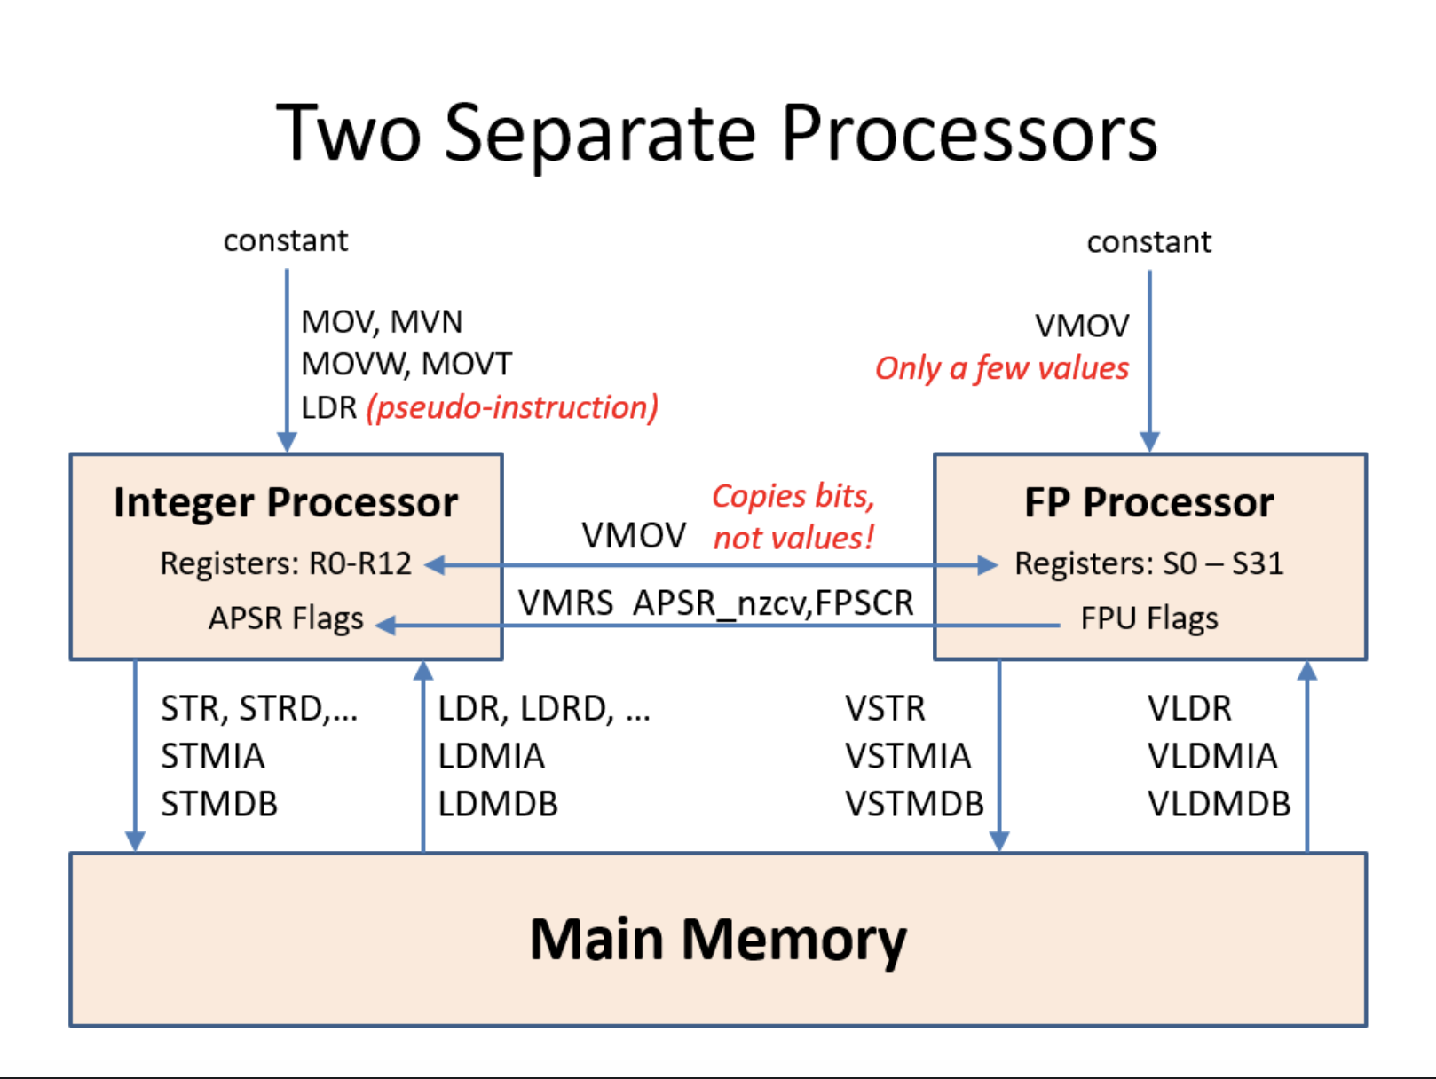
FLOATING-POINT UNIT
Notes:
So the ARM processor contains two separate computational units: The integer or the core unit and a floating-point unit. Explain the slide.
FPSCR = Floating Point Status and Control Register.
VMRS = Transfer FPU Flags to core unit APSR Flags (update nzcv flags on core unit).
Values are NOT converted between integer and floating-point representations and vice versa by just copying them from the Rs to Ss.

Slide 21
FLOATING-POINT PUSH & POP
Instruction | Syntax | Operation
Push FPU Registers | VPUSH { register list } | SP = SP – 4 × #registers, copy registers to mem[SP]
POP FPU Registers | VPOP { register list } | Copy mem[SP] to registers SP = SP + 4 × #registers
Use these instructions at function entry and exit to preserve and restore any of the registers S16-S31 that are modified.
Notes:
Instructions to push and pop FPU registers (S16 – S31).

Slide 22
Preserving Floating-Point Registers
float foo(float f){
return bar(void) + f;
}
foo: // S0 = f
PUSH {R4,LR}
VMOV R4,S0
BL bar
VMOV S1,R4
VADD.F32 S0,S0,S1
POP {R4,PC}
Faster to preserve FPU registers in the core registers.
foo: // S0 = f
PUSH {LR} // preserve LR
VPUSH {S16} // preserve S16
VMOV S16,S0 // keep parameter f in S16
BL bar // may modify S0-S15 (and R0-R3, R12)
VADD.F32 S0,S0,S16 // S16 = parameter f
VPOP {S16} // restore S16
POP {PC} // return (uses stack copy of LR)

Slide 23




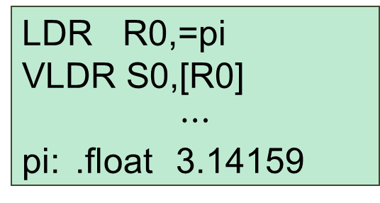
LOADING FLOATING-POINT CONSTANTS
Integer
Floating Point
Floating Point
MOV R0,5
VMOV S0,3.14159
VMOV S0,0.5
VMOV only works with a limited set of constants.
Integer
Floating Point
Floating Point
LDR R0,=5
VLDR S0,=3.14159
LDR R0,=pi
VLDR S0,[R0]
$$⋯$$
pi: .float 3.14159
VLDR cannot be used as a pseudo-instruction.
Notes:
These are a few differences between instructions on the core unit versus instructions on the Floating Point unit. CLICK…
The assembler directive (.float) creates a memory location (variable) to hold an arbitrary constant such as PI. Then use VLDR to load it from that memory location/variable.

Slide 24
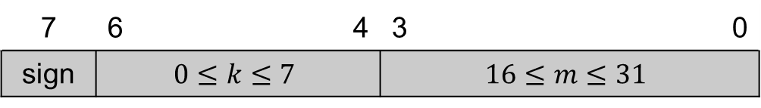

VMOV Immediate Constants
The encoding of the VMOV instruction only provides 8 bits for a floating-point constant:
VMOV constants are limited to ${±m}/{2^{k}}$
7 | 6 |  | 4 | 3 |  |  | 0
sign | $$0≤k≤7$$ |  |  | $$16≤m≤31$$

Slide 25
VMOV Immediate Constants
Visual Studio Example (VMOV)
0.125 0.1328125 0.140625 0.1484375 0.15625 0.1640625 0.171875 0.1796875 0.1875 0.1953125 0.203125 0.2109375 0.21875 0.2265625 0.234375 0.2421875 | 0.25 0.265625 0.28125 0.296875 0.3125 0.328125 0.34375 0.359375 0.375 0.390625 0.40625 0.421875 0.4375 0.453125 0.46875 0.484375 | 0.5 0.53125 0.5625 0.59375 0.625 0.65625 0.6875 0.71875 0.75 0.78125 0.8125 0.84375 0.875 0.90625 0.9375 0.96875 | 1.0 1.0625 1.125 1.1875 1.25 1.3125 1.375 1.4375 1.5 1.5625 1.625 1.6875 1.75 1.8125 1.875 1.9375 | 2.0 2.125 2.25 2.375 2.5 2.625 2.75 2.875 3.0 3.125 3.25 3.375 3.5 3.625 3.75 3.875 | 4.0 4.25 4.5 4.75 5.0 5.25 5.5 5.75 6.0 6.25 6.5 6.75 7.0 7.25 7.5 7.75 | 8.0 8.5 9.0 9.5 10.0 10.5 11.0 11.5 12.0 12.5 13.0 13.5 14.0 14.5 15.0 15.5 | 16.0 17.0 18.0 19.0 20.0 21.0 22.0 23.0 24.0 25.0 26.0 27.0 28.0 29.0 30.0 31.0
VMOV works for constants equal to ±m × 2^{-k}, where 16 ≤ m ≤ 31 and 0 ≤ k ≤ 7
For m = 17 and k = 4 → 17 x 2⁻⁴ = 1.0625
Notes:
There are only a total of 128 values that can be used by VMOV immediate instruction. These 128 values are:

Slide 26
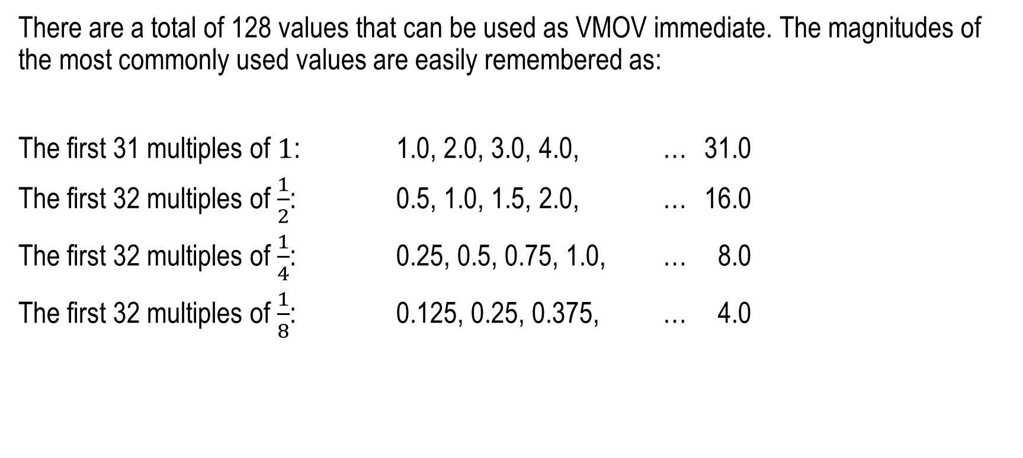
Common VMOV Immediates
There are a total of 128 values that can be used as VMOV immediate. The magnitudes of the most commonly used values are easily remembered as:
The first 31 multiples of $1$: 1.0, 2.0, 3.0, 4.0, … 31.0
The first 32 multiples of $\frac{1}{2}$: 0.5, 1.0, 1.5, 2.0, … 16.0
The first 32 multiples of $\frac{1}{4}$: 0.25, 0.5, 0.75, 1.0, … 8.0
The first 32 multiples of $\frac{1}{8}$: 0.125, 0.25, 0.375, … 4.0
Not supported:
VMOV S0,0.0
Use this instead:
VSUB.F32 S0,S0,S0
https://www.h-schmidt.net/FloatConverter/IEEE754.html

Slide 27
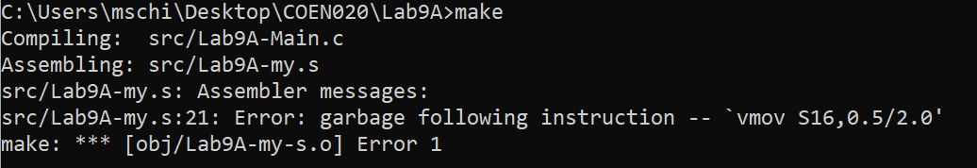
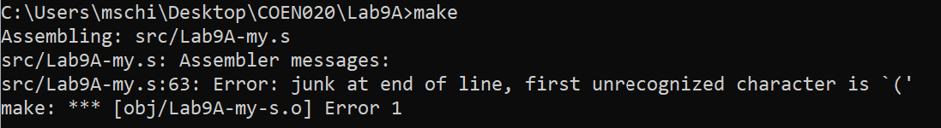
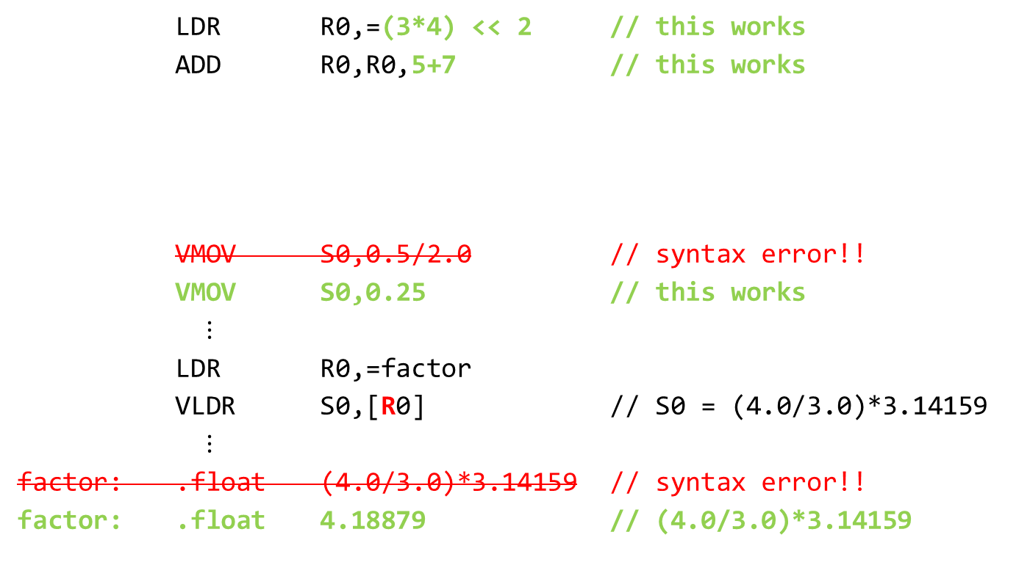
Using Expressions to Create Constants
LDR R0,=(3*4) << 2 // this works
ADD R0,R0,5+7 // this works
VMOV S0,0.5/2.0 // syntax error!!
VMOV S0,0.25 // this works
$⋮$
LDR R0,=factor
VLDR S0,[R0] // S0 = (4.0/3.0)*3.14159
$⋮$
factor: .float (4.0/3.0)*3.14159 // syntax error!!
factor: .float 4.18879 // (4.0/3.0)*3.14159
But you can't use expressions for floating-point constants:

Slide 28
COPYING FLOATING-POINT DATA - Register -> Register
Instruction | Syntax | Operation
Move FP Register to FP Register | VMOV S_{d},S_{m} | S_{d} = S_{m}
Move FP Register to Core Register | VMOV R_{d},S_{m} | R_{d} = S_{m}
Move Core Register to FP Register | VMOV S_{d},R_{m} | S_{d} = R_{m}
Move 2 FP Registers to Core Registers | VMOV R_{t},R_{t2},S_{m},S_{m1} | R_{t} = S_{m} ; R_{t2} = S_{m1} Note: m1 = m + 1
Move 2 Core Registers to FP Registers | VMOV S_{m},S_{m1},R_{t},R_{t2} | S_{m} = R_{t} ; S_{m1} = R_{t2} Note: m1 = m + 1
These only copy data. They do NOT convert between integer and floating-point representations.
Notes:
So please note: Moving from FP to Core register and vice versa will perform a bit by bit transfer and no conversion is performed.

Slide 29
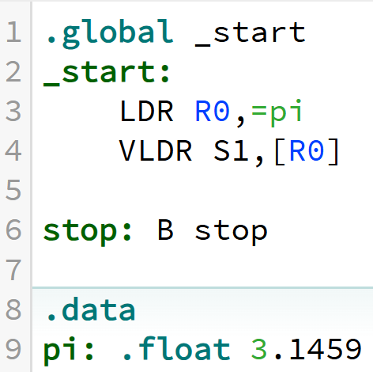
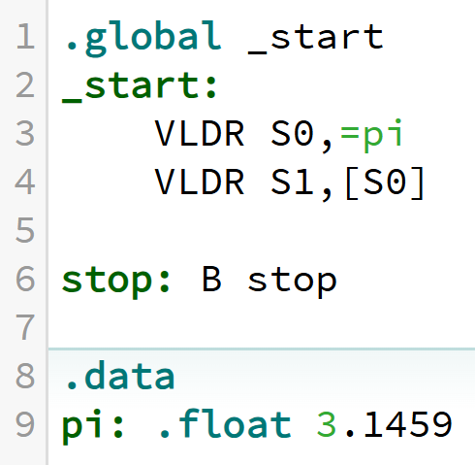
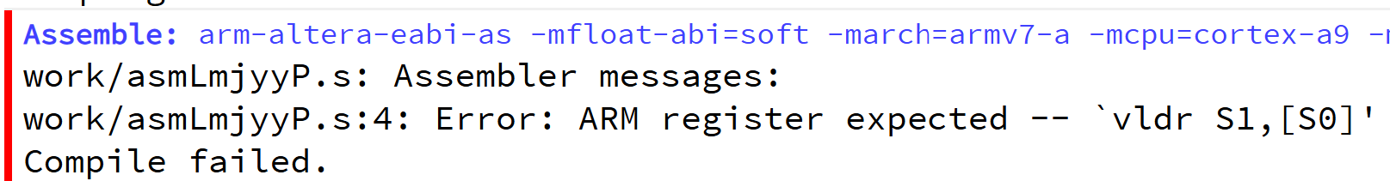
COPYING FLOATING-POINT DATA - Memory -> (Single or Double) Register
Instruction | Syntax | Operation
Load single-precision FPU Register from Memory | VLDR S_{d},[R_{n}] | S_{d} = mem₃₂[R_{n}]
 | VLDR S_{d},[R_{n}, constant] | S_{d} = mem₃₂[R_{n} + constant]
 | VLDR S_{d},=label | S_{d} = mem₃₂[addrs of label]
Load double-precision FPU Register from Memory | VLDR D_{d},[R_{n}] | D_{d} = mem₆₄[R_{n}]
 | VLDR D_{d},[R_{n}, constant] | D_{d} = mem₆₄[R_{n} + constant]
 | VLDR D_{d},=label | D_{d} = mem₆₄[addrs of label]
OK
Error
PC-relative can only be used to reference constants stored in the read-only code space (near the instruction).
CPULator: 01-pi.s
Notes:
Label is a variable name in memory (like x, or y).

Slide 30
COPYING FLOATING-POINT DATA - Register -> (Single or Double) Memory
Instruction | Syntax | Operation
Store single-precision FPU Register to Memory | VSTR S_{d},[R_{n}] | S_{d} = mem₃₂[R_{n}]
 | VSTR S_{d},[R_{n},constant] | S_{d} = mem₃₂[R_{n} + constant]
 | VSTR S_{d},=label | S_{d} = mem₃₂[address of label]
Store double-precision FPU Register to Memory | VSTR D_{d},[R_{n}] | D_{d} = mem₆₄[R_{n}]
 | VSTR D_{d},[R_{n},constant] | D_{d} = mem₆₄[R_{n} + constant]
 | VSTR D_{d},=label | D_{d} = mem₆₄[address of label]
Notes:
Does not support VSTR Sd, <variable in mem>

Slide 31
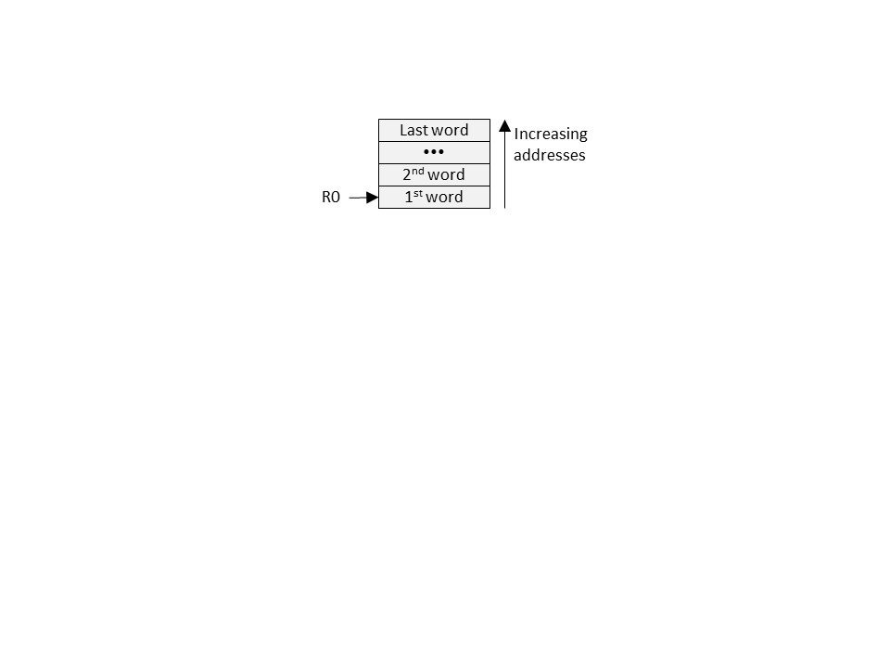
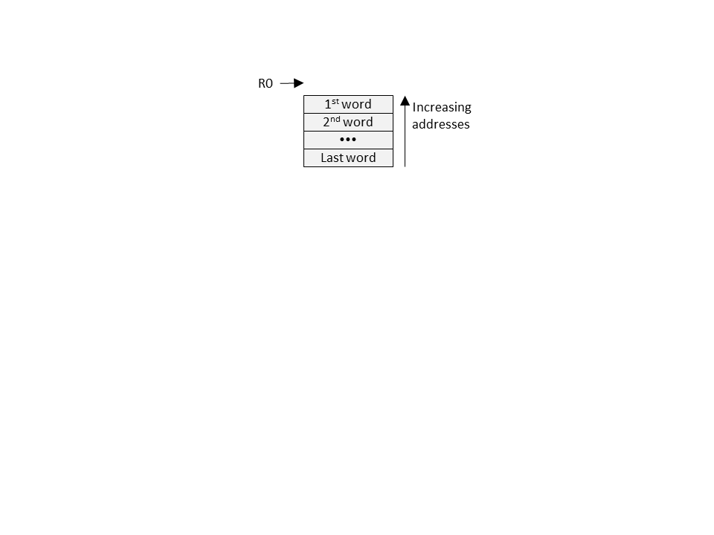
LOADING FLOATING-POINT DATA - Memory to Multiple Registers
Instruction | Syntax | Operation
Load Multiple FPU Registers, Increment After | VLDMIA R_{n}!,register list | FP registers = memory, 1st address in R_{n}; Updates R_{n} only if write-back flag (!) is appended to R_{n}.
Load Multiple FPU Registers, Decrement Before | VLDMDB R_{n}!,register list | FP registers = memory, addresses end just before address in R_{n}; Must append (!) and always updates R_{n}
// Copy starting at mem[R0] VLDMIA R0!,{S0,S1,S2} (i++)
// Copy ending before mem[R0] VLDMDB R0!,{S0-S5} (++i)

Slide 32
STORING FLOATING-POINT DATA - 1, 2 or Multiple Registers to Memory
Instruction | Syntax | Operation
Store single-precision FPU Register to Memory | VSTR S_{d},[R_{n}] | S_{d} → mem₃₂[R_{n}]
 | VSTR S_{d},[R_{n},constant] | S_{d} → mem₃₂[R_{n} + constant]
Store double-precision FPU Register to Memory | VSTR D_{d},[R_{n}] | D_{d} → mem₆₄[R_{n}]
 | VSTR D_{d},[R_{n},constant] | D_{d} → mem₆₄[R_{n} + constant]
Store Multiple FPU Registers, Increment After | VSTMIA R_{n}!,register list | FP registers → memory, 1st address in R_{n}; Updates R_{n} only if write-back flag (!) is appended to R_{n}.
Store Multiple FPU Registers, Decrement Before | VSTMDB R_{n}!,register list | FP registers → memory, addresses end just before address in R_{n}; Must append (!) and always updates R_{n}

Slide 33
INSTRUCTION SUFFIXES
Used with VCVT* when converting between floating-point and integer values to specify the data type of the source and destination:
.F32 32-bit single-precision float
.S32 32-bit signed (2’s comp) integer
.U32 32-bit unsigned integer
The two VCVT operands must both be FPU registers (S0-S31)!
* (Floating point convert)

Slide 34
CONVERTING BETWEEN - INTEGER AND FLOATING POINT
Instruction | Syntax | Operation
Convert Unsigned Integer to Floating-Point (float ← uint32_t) | VCVT.F32.U32 S_{d},S_{m} | S_{d} = (float) S_{m}, where S_{m} is an unsigned integer
Convert 2’s complement Integer to Floating-Point (float ← int32_t) | VCVT.F32.S32 S_{d},S_{m} | S_{d} = (float) S_{m}, where S_{m} is a signed integer
Convert Floating-Point to Unsigned Integer (uint32_t ← float) | VCVT.U32.F32 S_{d},S_{m} | S_{d} = (uint32_t) S_{m}
 | VCVTR.U32.F32 S_{d},S_{m}
Convert Floating-Point to signed Integer (int32_t ← float) | VCVT.S32.F32 S_{d},S_{m} | S_{d} = (int32_t) S_{m}
 | VCVTR.S32.F32 S_{d},S_{m}
Default:
VCVTR uses ToNEAR
VCVT uses ToZERO
Notes:
We can convert from signed and unsigned integers to floating point and vice versa.
Having the R appended to VCVT or not has to do with the rounding mode you would like to use. Next slide we are going to cover these rounding modes.

Slide 35
ROUNDING MODES
Rounding Mode | IEEE Abbrev. | FPSCR bits 23..22 | Examples
 |  |  | -2.5 | -1.5 | +1.5 | +2.5
Round to nearest even (default) | ToNEAR | 00 | -2 | -2 | +2 | +2
Round towards positive infinity | ToPOSV | 01 | -2 | -1 | +2 | +3
Round towards negative infinity | ToNEGV | 10 | -3 | -2 | +1 | +2
Round towards zero (truncate) | ToZERO | 11 | -2 | -1 | +1 | +2
Default:
VCVTR uses ToNEAR
VCVT uses ToZERO
-
0
+
Notes:
Floating-point Status and Control Register (FPSCR)
ToZero means towards zero OR Truncate

Slide 36
float versus int32_t POSITVE
31 |  |  |  |  |  |  |  |  |  |  |  |  |  |  |  |  |  |  |  |  |  |  |  |  |  |  |  |  |  |  | 0
0 | 0 | 0 | 0 | 0 | 0 | 0 | 0 | 0 | 0 | 0 | 0 | 0 | 0 | 0 | 0 | 0 | 0 | 0 | 0 | 0 | 0 | 1 | 1 | 1 | 1 | 1 | 0 | 1 | 0 | 0 | 0
int32_t y = +1000 ;
S_{d}
float x = +1000.5 ; // or +(000001111101000.1₂₎
31 | 30 | excess 127 exponent |  |  |  |  |  | 23 | 22 | significand |  |  |  |  |  |  |  |  |  |  |  |  |  |  |  |  |  |  |  |  | 0
0 | 1 | 0 | 0 | 0 | 1 | 0 | 0 | 0 | 1 | 1 | 1 | 1 | 0 | 1 | 0 | 0 | 0 | 1 | 0 | 0 | 0 | 0 | 0 | 0 | 0 | 0 | 0 | 0 | 0 | 0 | 0
VCVT.S32.F32 S_{d}, S_{m}
S_{m}
136₁₀
1111010001
value₂ = + 1.1111010001 × 2⁹ or (1000.5₁₀)
Notes:
Here the CVT.S32.F32 S_{d} ← (int32_t) S_{m}
where S_{m} is a float rounded towards zero (or truncate).

Slide 37
float versus int32_t NEGATIVE
31 |  |  |  |  |  |  |  |  |  |  |  |  |  |  |  |  |  |  |  |  |  |  |  |  |  |  |  |  |  |  | 0
1 | 1 | 1 | 1 | 1 | 1 | 1 | 1 | 1 | 1 | 1 | 1 | 1 | 1 | 1 | 1 | 1 | 1 | 1 | 1 | 1 | 1 | 0 | 0 | 0 | 0 | 0 | 1 | 1 | 0 | 0 | 0
int32_t y = -1000;
S_{d}
float x = -1000.5 ; // or –(000001111101000.1₂)
31 | 30 | excess 127 exponent |  |  |  |  |  | 23 | 22 | significand |  |  |  |  |  |  |  |  |  |  |  |  |  |  |  |  |  |  |  |  | 0
1 | 1 | 0 | 0 | 0 | 1 | 0 | 0 | 0 | 1 | 1 | 1 | 1 | 0 | 1 | 0 | 0 | 0 | 1 | 0 | 0 | 0 | 0 | 0 | 0 | 0 | 0 | 0 | 0 | 0 | 0 | 0
VCVT.S32.F32 S_{d}, S_{m}
S_{m}
136₁₀
1111010001
value₂ = - 1.1111010001 × 2⁹ or (1000.5₁₀)
Notes:
Here the CVT.S32.F32 S_{d} ← (int32_t) S_{m}
where S_{m} is a float rounded towards zero (or truncate).

Slide 38
ARITHMETIC WITH REAL NUMBERS
Instruction | Syntax | Operation
Floating-point add | VADD.F32 S_{d},S_{n},S_{m} | S_{d} = S_{n} + S_{m}
Floating-point subtract | VSUB.F32 S_{d},S_{n},S_{m} | S_{d} = S_{n} − S_{m}
Floating-point negate | VNEG.F32 S_{d},S_{m} | S_{d} = −S_{m}
Floating-point abs value | VABS.F32 S_{d},S_{m} | S_{d} = | S_{m} | (clears FPU sign bit, N)
Floating-point multiply | VMUL.F32 S_{d},S_{n},S_{m} | S_{d} = S_{n} × S_{m}
Floating-point divide | VDIV.F32 S_{d},S_{n},S_{m} | S_{d} = S_{n} ÷ S_{m}
Floating-point square root | VSQRT.F32 S_{d},S_{m} | S_{d} = (SQRT) S_{m}
Floating-point Multiply and Add | VMLA.F32 S_{d},S_{n},S_{m} | S_{d} = S_{d} + S_{n} × S_{m}
Floating-point Multiply and Subtract | VMLS.F32 S_{d},S_{n},S_{m} | S_{d} = S_{d} − S_{n} × S_{m}
In general, the floating-point arithmetic instructions do not set the flags.
Notes:
FPSCR (Floating Point Status and Control Register)
APSR (Application Program Status Register).

Slide 39
FUNCTION PARAMETERS AND RETURN VALUES
Parameters:
Data of type float is passed in S0-S15
Left-most float in S0, next float in S1, etc.
Pointer to float is passed in R0-R3
Return Value:
Result of type float is returned in S0
Result of type float * is returned in R0

Slide 40
EXAMPLE
float foo(int, float, float *, float);
float f1, f2;
f2 = foo(5, 0.25, &f1, 1.0);
LDR R0,=5 // R0 = integer constant 5
VMOV S0,0.25 // S0 = fl-pt constant 0.25
LDR R1,=f1 // R1 = address of f1
VLDR S2,[R1]
VMOV S1,1.0 // S1 = fl-pt constant 1.0
BL foo // call function foo
LDR R0,=f2 // R0 = address of f2
VSTR S0,[R0] // store S0 in f2

Slide 41
Algorithm Examples

Slide 42
Another Floating-Point Example
CPULator: 02-VolumOfaCube.s
// S0 S1 S2
float VolumeOfCube(float height, float width, float depth){
return height * width * depth;
}
VolumeOfCube: // S0 = height, S1 = width, S2 = depth
VMUL.F32 S0,S0,S1 // S0 = height * width
VMUL.F32 S0,S0,S2 // S0 = height * width * depth
BX LR

Slide 43
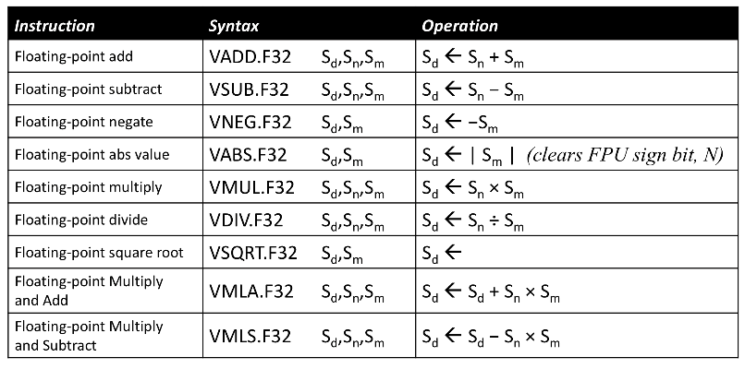
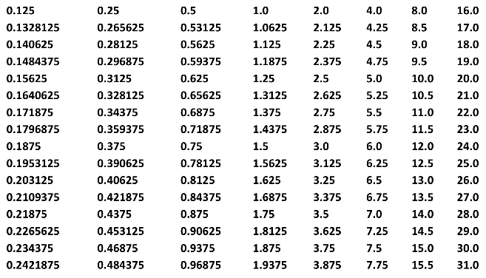
Special Floating-Point Constants
CPULator: 03-Discriminant.s
// S0 S1
float Discriminant(float a, float b, float c){
return b * b – 4.0 * a * c ;
}
Discriminant: // S0 = a, S1 = b, S2 = c
VMUL.F32 S1,S1,S1 // S1 = b*b
VMOV S3,#4.0 // S3 = 4.0
VMUL.F32 S3,S3,S0 // S3 = 4.0*a
VMUL.F32 S3,S3,S2 // S3 = 4.0*a*c
VSUB.F32 S0,S1,S3 // S0 = b*b – 4.0*a*c
BX LR
VMOV works for constants equal to ±m × 2^{-n}, where 16 ≤ m ≤ 31 and 0 ≤ n ≤ 7

Slide 44
Arbitrary Floating-Point Constants
CPULator: 04-AreaOfCircle.s
// S0
float AreaOfCircle(float radius){
return 3.14159 * radius * radius; }
AreaOfCircle: // S0 = radius
VMUL.F32 S0,S0,S0 // S0 = radius*radius
LDR R0,=pi // S1 = 3.14159
VLDR S1,[R0]
VMUL.F32 S0,S0,S1 // S0 = 3.14159*radius*radius
BX LR
pi: .float 3.14159
Place data near the corresponding instruction – preferably below the function

Slide 45
Using Expressions to Create Constants
CPULator: 05-VolumeOfSphere.s
// S0
float VolumeOfSphere(float radius){
return (4.0 / 3.0) * 3.14159 * radius * radius * radius;
}
VolumeOfSphere: // S0 = radius
VMUL.F32 S1,S0,S0 // S1 = radius * radius
VMUL.F32 S0,S0,S1 // S0 = radius * radius * radius
LDR R0,=factor
VLDR S1,[R0] // S1 = (4.0/3.0)*3.14159
VMUL.F32 S0,S0,S1 // S0 = ((4.0*3.14159)/3.0)*radius^3
BX LR
factor: .float 4.18879 // (4.0/3.0)*3.14159
You can't use expressions in the .float directive like you can with .word

Slide 46
Preserving Floating-Point Registers
CPULator: 06-VolumeOfCone.s
S0
S1
float VolumeOfCone(float radius, float height){
return AreaOfCircle(radius) * height / 3.0 ;
}
VolumeOfCone: // S0 = radius, S1 = height
PUSH {R4,LR} // Preserve R4 and LR
VMOV R4,S1 // R4 = height (S1 could be used // inside the AreaOfCircle function as // a scratch register
BL AreaOfCircle // S0 = area of base of cone
VMOV S1,R4 // S1 = height
VMUL.F32 S0,S0,S1 // S0 = height * (area of base)
VMOV S1,#3.0 // S1 = 3.0
VDIV.F32 S0,S0,S1 // S0 = (height * (area of base))/3.0
POP {R4,PC} // Restore R4 and return
Easiest to preserve FPU registers in core registers.
Notes:
Pi * r² * h / 3

Slide 47
Done

